Slide 1


FALL 2022
DUAL CREDIT ORIENTATION
By: (insert name)
Collin College and Career Counselor
Notes:
Justin

Slide 2
Opening Remarks and Reminders
Start date
Friday procedures
Attendance
Class getting cancelled—what to do//where to go
Brief note about registration for the Spring
End of the term processes and procedures
Notes:
Jessica

Slide 3
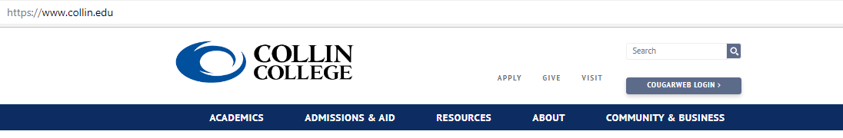
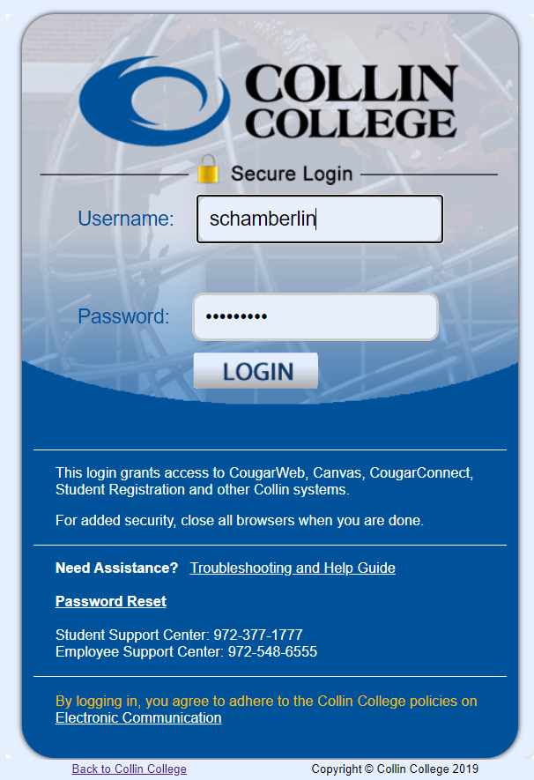
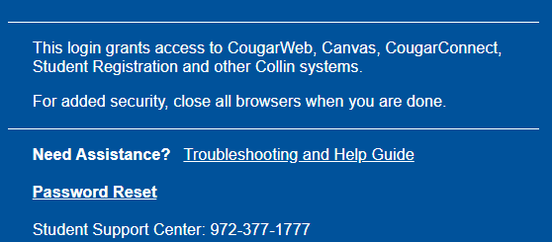
LOGGING IN AND GAINING ACCESS
Student should have CWID#, username, and password,
If the password is not working call Student Technical Support.
Notes:
Jessica

Slide 4
STUDENT TECHNICAL SUPPORT
Please save this number in your phone:
972.377.1777
They are available 24/7.
Notes:
Jessica

Slide 5
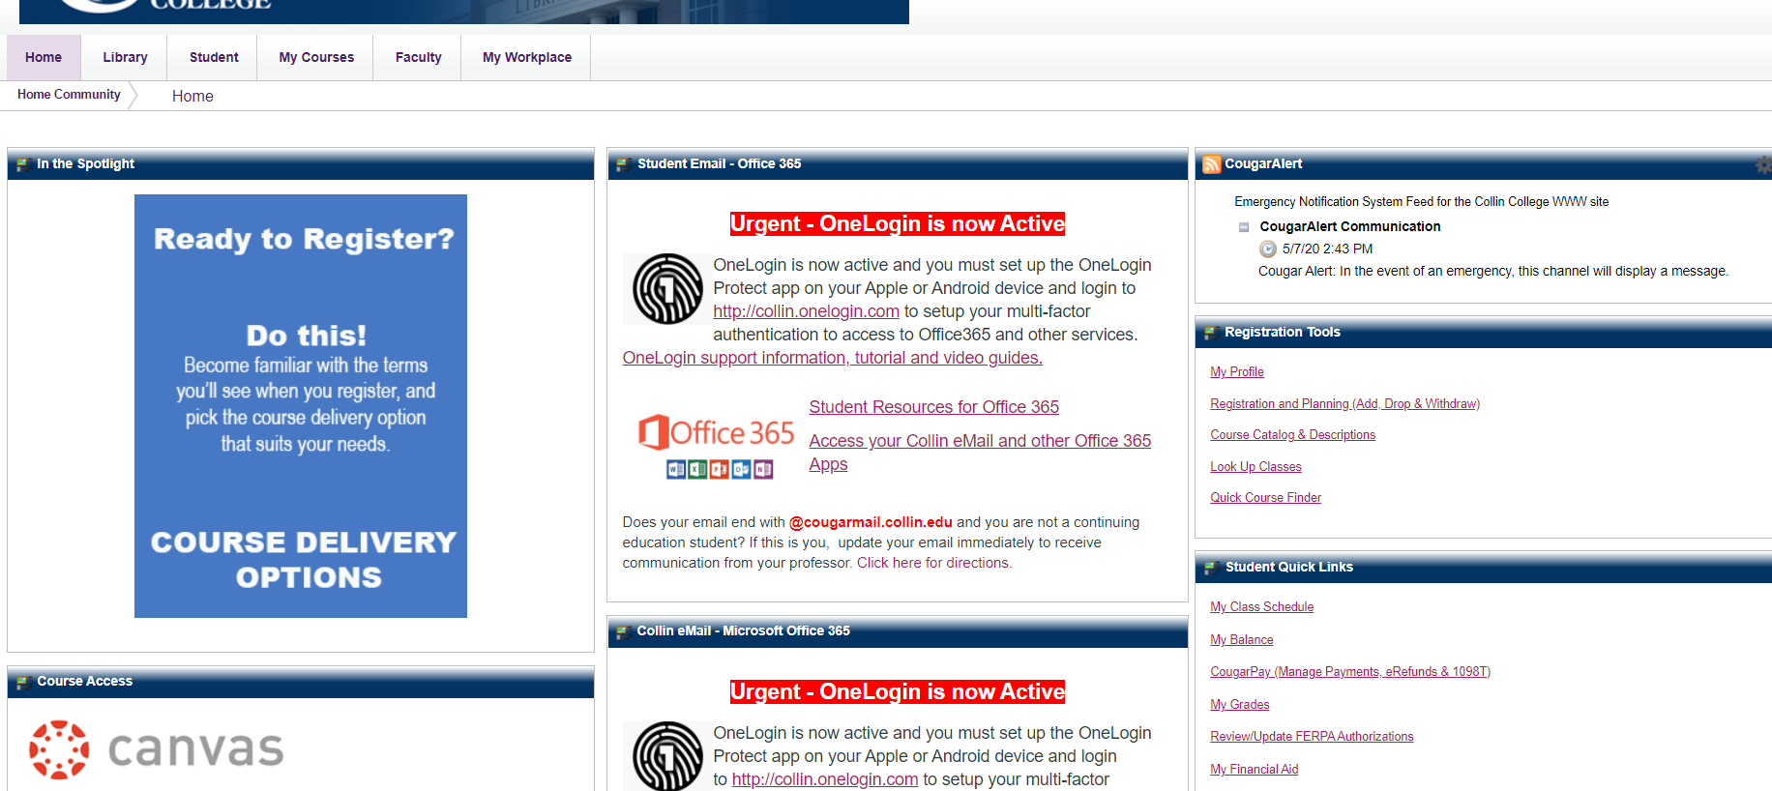
FERPA
As you may know, college students have a right to confidentiality and privacy. Professors, Collin Counselors, and other Collin College staff cannot provide parents with details about holds or grades, among other information.
Students that would like to grant access to their protected information may do so within their Cougar Web. From the “Home” tab, find “Student Quick Links”, and click on: “Review/Update FERPA Authorizations.”
Notes:
Jessica

Slide 6
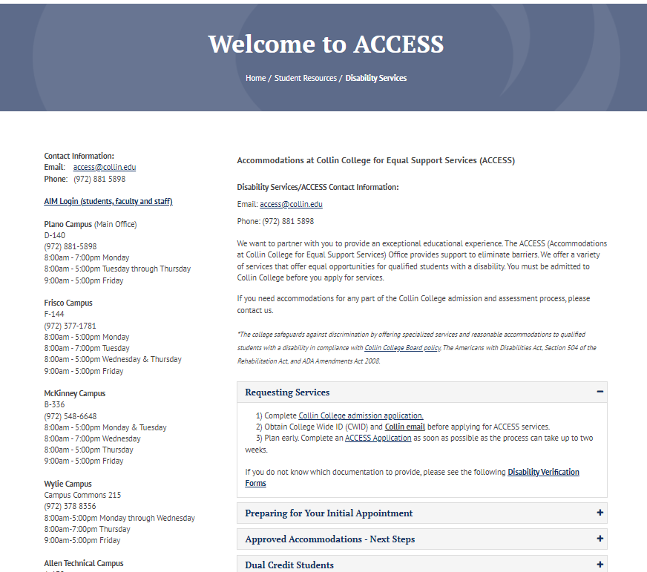
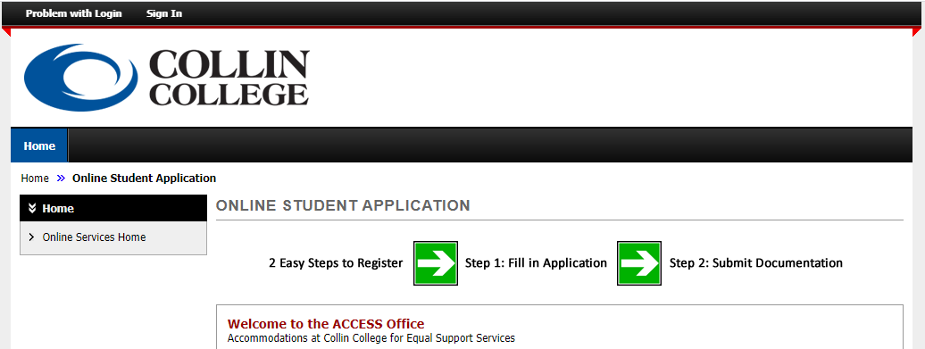
ACCESS
(ACCOMMODATIONS AT COLLIN COLLEGE FOR
EQUAL SUPPORT SERVICES)
Students with disabilities may request to receive accommodations by completing the online ACCESS application
This must be done EACH semester
High school 504 plans do not automatically transfer
Students must schedule an appointment with the ACCESS office before the semester begins
Students must provide documentation of his/her disability
Notes:
Jessica

Slide 7


CONGRATULATIONS! You’re ready to start
HERE’S HOW TO BE SUCCESSFUL IN YOUR DUAL CREDIT COURSES
Notes:
Jessica

Slide 8
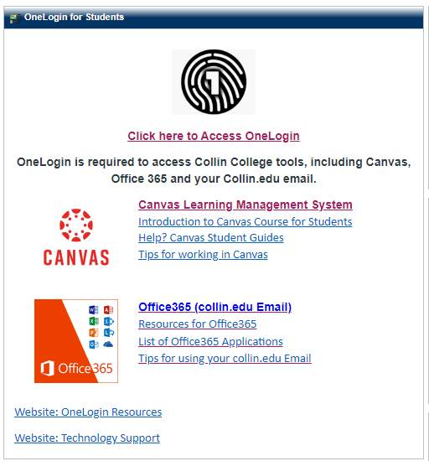
SETUP YOUR EMAIL
Collin College has transitioned to a more secure login system using Microsoft Office.
You will need to download the OneLogin app to your phone.
Make sure you can log into your Collin email BEFORE the first day of class.
This information can be found on the “Home” tab of your CougarWeb. We recommend the Outlook app for quick access to your emails.
Notes:
Jessica

Slide 9
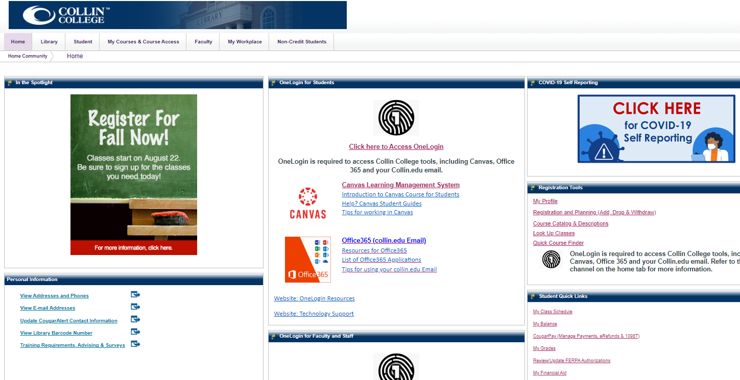
HOW TO VIEW YOUR SCHEDULE
Notes:
Jessica

Slide 10

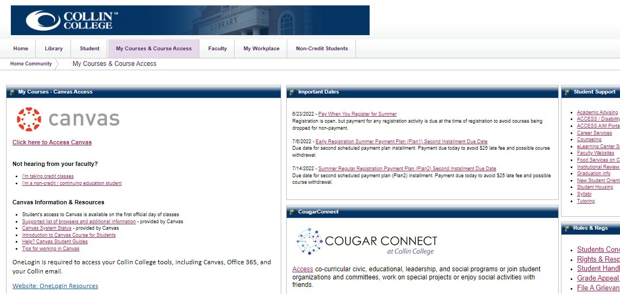
WHERE ARE MY COURSES?
From the “My Courses” tab,
click on Access Canvas
Once inside Canvas, you can use the side navigation panel to find your class(es)
Courses will not be active until the first day of class.
Notes:
Jessica

Slide 11
TEXTBOOKS
We like to recommend students view their course syllabus for textbook requirements. Some instructors may not require a book or will provide the materials they would like to use during the semester.
If a textbook is needed, after the first day of class you can visit our Collin College Bookstore online at https://secure.bncollege.com/shop/collin-preston/home.
Bookstore price matches: Amazon, bn.com, and local competitors.
You may have a $75 Dollar Fee for e-materials/Textbook for your class. Check with your professor to see if this is the case.
Notes:
Jessica

Slide 12
HOW TO SUCCEED IN CLASS
UNDERSTANDING EXPECTATIONS
Notes:
Tonya

Slide 13
WHAT KIND OF LEARNING CAN I EXPECT?
Online Courses are asynchronous.
Lecture/Lab In-person Classroom Course: Regularly scheduled face-to-face meetings at a specific campus location; some use of technology to support learning.
Hybrid Classroom Course: Regularly scheduled face-to-face meetings at a specific campus location mixed with online instruction.
Blended Online Course: Majority of the instruction is online, with some required activities scheduled at a campus location. Instructor posts meeting times in the course syllabus and in Canvas.
*Consult with your professor about testing requirements.
Notes:
Tonya

Slide 14

WHAT IS A SYLLABUS?
A document that communicates information about a specific course and explains the rules, responsibilities, and learning outcomes associated with that course.
Generally, it will include course policies, rules and regulations, required texts, and a schedule of assignments and deadlines.
A syllabus can tell you nearly everything you need to know about how a course will be run and what will be expected of you.
All professors will write and use their syllabi differently.
Notes:
Tonya

Slide 15


GRADES, ATTENDANCE, and PARTICIPATION
A portion of your grade may be set for attendance and participation.
If you are going to miss class because of any extracurricular activities, please reach out to your professor beforehand.
Participate in class by taking notes, asking questions, engaging in group discussions, etc.
Notes:
Jessica

Slide 16
HIGH SCHOOL VS. COLLEGE
High School
College
High school is MANDATORY and usually FREE
College is VOLUNTARY and EXPENSIVE
Your time is structured by your TEACHERS
YOU manage your own time
You can count on PARENTS and TEACHERS to remind you of assignments, priorities, and deadlines
YOU must balance your responsibilities and set priorities. YOU are expected to take responsibility for what you do/don’t do
Testing is FREQUENT and covers material AS YOU GO ALONG
Testing is NOT FREQUENT and covers LARGE amounts of material
Teachers frequently conduct REVIEW SESSIONS, pointing out important concepts
YOU, not the professor, are expected to PREPARE YOURSELF for a test
Teachers frequently rearrange test dates to AVOID CONFLICT with school events
Professors usually schedule tests WITHOUT REGARD for other classes or outside activities
You are NOT responsible for knowing what you need for graduation
Graduation requirements are COMPLEX and differ for each college
Parents CAN talk to your teachers without your permission
ONLY THE STUDENT can speak with their professor about their class, unless a FERPA waiver has been authorized
Notes:
Tonya

Slide 17
HOW AND WHEN TO CONTACT PROFESSOR
Use your @collin.edu email address at all times
When using CANVAS inbox, there is no guarantee the professor will see the message
Communicate with professor often Communication is KEY to a successful semester
Due to FERPA, professors are not allowed to give any information about your grades, progress or anything related to your account to your parents or guardians without a waiver
When to contact your professor:
Not understanding the subject
Missing grades in your gradebook
COVID-related issues
Missing a class meeting
Checking on your grade
Questions about an assignment
Notes:
Jessica

Slide 18




EMAIL ETIQUETTE
*When emailing a professor, a counselor, or simply a staff member start with a greeting:
Good Morning Professor Wallace,
My name is Jordan Hamilton, CWID: 100123456. I’m reaching out to you today because I have a question about our latest homework assignment…
*Always state your name and your CWID number
WAIT AT LEAST 48 HOURS FOR A RESPONSE
DO NOT CALL ANYONE BY THEIR FIRST NAME.
FOLLOW UP WITH YOUR PROFESSOR/COUNSELOR
SEND A "THANK YOU" EMAIL
Notes:
Jessica

Slide 19
RESOURCES
TO HELP YOU SUCCEED
Notes:
Jessica

Slide 20
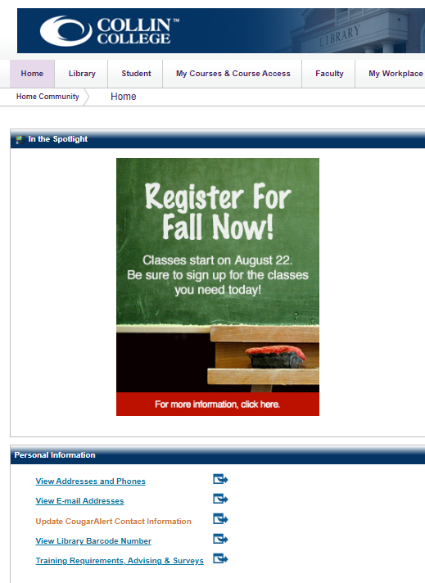
STAY SAFE
Cougar Alert: Sign up for alerts regarding weather, emergencies, and closures.
On your home tab, look for the "Personal Information" channel in the lower right corner, and click on "Update Cougar Alert Contact Information."
Notes:
Jessica

Slide 21
COLLIN RESOURCES
The Writing Lab assist students to enhance their writing assignments.
The Math Lab assists students to enhance the knowledge of any Math or science course.
The Science Den and microscope use is open for independent study during the library’s regular hours.
Library Study Rooms provide a quiet, comfortable space to work alone or with a small group.
Makerspaces are collaborative learning environments where students gather to make works, share materials, and learn new skills.
Use your Collin College ID Card to check out books, laptops, calculators, work out in the gym, etc. Your Collin College ID will be available at the Student Engagement Office at any Collin College campus.
Notes:
Jessica

Slide 22
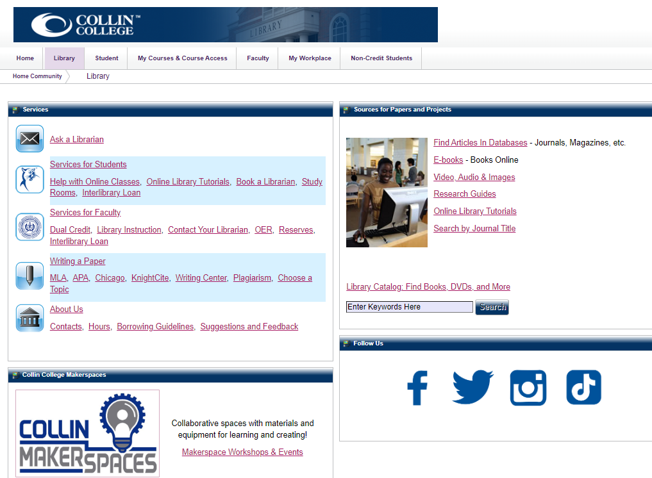
WHAT IF I NEED HELP?
Start with your professor’s syllabus
Writing Lab https://www.collin.edu/studentresources/writingcenter/prcwritingcenter.html
Math Lab https://www.collin.edu/studentresources/mathlab/prc.html
Library (peer reviewed articles, writing papers)
Talk with your High School Counselor
Talk with your Collin College Counselor
Notes:
Jessica

Slide 23
Some students may find dual credit more of a challenge than expected.
Here’s what to do if you are struggling in a class:
#1. Talk with your professor about the challenges you are facing. Their contact information will be on the syllabus for email, phone number, and “office hours.”
#2. Talk with your High School Counselor about other course options if you plan to drop your dual credit course.
#3. Consider dropping the course.
Once the course begins (Aug. 22) students have until Sept. 6 to drop a 16 week course, and it will not reflect on their college transcript. After Sept. 6 the student will receive a "W" on their college transcript. A refund for the course ranges from 70% to 0% and is based on the day the student drops/withdraws from the course. Please talk with your Collin Counselor at your high school for specifics. Last day to withdraw is Oct. 28. After Oct. 28, whatever grade you are receiving in the course stands and will be reflected on your transcript.
*If you are enrolled in a course that is less than 16 weeks long, please speak with your Professor or Collin College Counselor for drop/withdraw deadlines.
Notes:
Jessica

Slide 24
BEST PRACTICES
Develop a Routine: Get in the habit of logging in every day to review the week’s assignments, if your professor publishes on your Canvas or refer to their syllabus.
Get Organized: Keep an assignment tracker on your phone, computer, or planner. Check off assignments once they are submitted. Look at your assignments daily.
Stay on Track: Don’t wait until the last minute. As a reminder, expect to study at least 3-4 hours per week PER CLASS.
Ask for Clarification: Reach out to familiar classmates about assignments.
Get Every Possible Point: Don’t take points off the board with incomplete work or by missing deadlines.
Notes:
Jessica

Slide 25

COLLEGE AND CAREER COUNSELOR
Dr. Jessica A. Robinson
I am your Collin College and Career Counselor
Located at Hebron High School
Counseling Center
(972) 553-1105
JARobinson@Collin.edu
Insert your photo here
Notes:
Jessica

Slide 26
IMPORTANT DATES
Fall Classes Begin: Aug. 22
Labor Day (Collin Campuses are Closed): Sept. 5
Census Date: Sept. 6
Withdraw Deadline: Oct. 28
Thanksgiving Break: Nov. 23-27
Final Exam Week: Dec. 5-11
Notes:
Jessica

Slide 27
Academic Integrity:
How to Stay Out of Hot Water
Hebron High School - August 18, 2022
Presented by:
Cheri Jack, Associate Dean of Students, Collin College
Notes:
Cheri

Slide 28
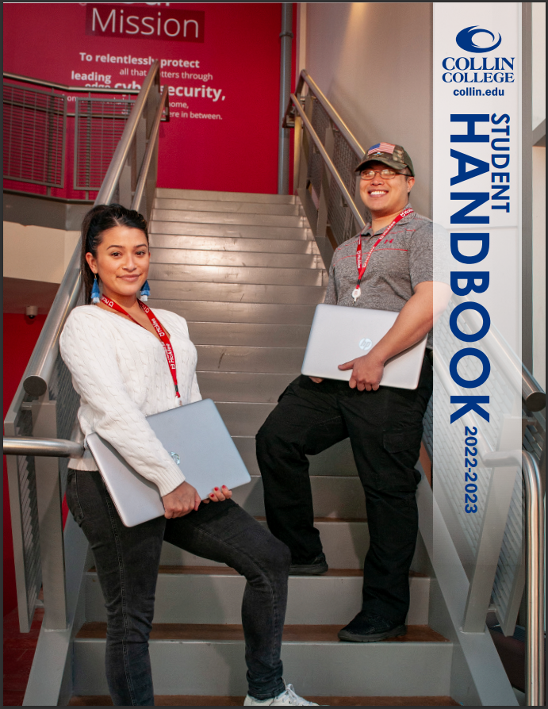
Why is the Student Code of Conduct Important?
As members of the Collin College academic community, students are subject to certain obligations and expectations by virtue of their membership.
Prior to the start of the spring 2022 semester, all Hebron High School dual credit students should read pages 94-139 in the Student Code of Conduct located in the 2022-2023 Collin College Student Handbook.
Notes:
Many students don’t read their high school code of conduct, so why should they read ours? (raise hands)
Department of Ed considers students an “adult,” regardless of their age when a student starts taking college classes, even if they are in high school.
All students are held to the same standards. The Student Code of Conduct are the rules for which all students must follow. If students break these rules, there will be consequences.
Handbook can be found online. On the main webpage, type in Student Handbook in the search bar, click on the 2021-2022 academic year to see the current policies.

Slide 29

Two Basic Standards of Behavior
Students “will adhere to the Collin College policies and municipal, county, state, and federal laws; and”
Students “will not interfere with or disrupt the orderly educational processes of Collin College.”
2022-2023 Collin College Student Handbook, p. 94.
Notes:
Cheri
How can a student “adhere” to college policies if they don’t even know what they are?

Slide 30
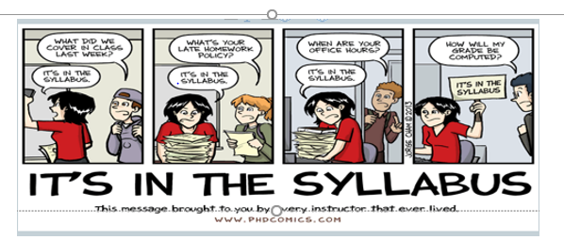
Why should I Read my Entire Syllabus?
Notes:
Cheri
Students only have a tendency to look at two sections of the syllabus: 1. deadlines 2. How they will be graded
Professor’s expectations of all students in the class outlined in the syllabus. Read all sections and then look at it again, before completing this task for the first time.
Give Example (For every direct quote a student includes in their written assignments, they will be docked one letter grade)
Sometimes professors add information to standard syllabus policies (i.e., scholastic dishonesty)

Slide 31
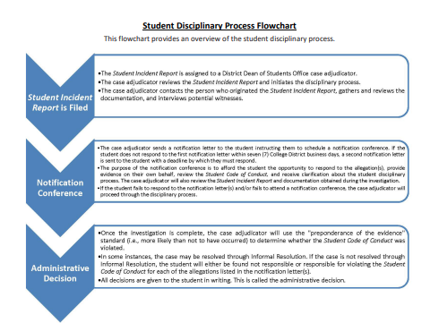
Notes:
Cheri
Make sure you tell students that they are allowed to bring someone with them to the notification conference such as a parent or their high school counselor, if they wish.

Slide 32
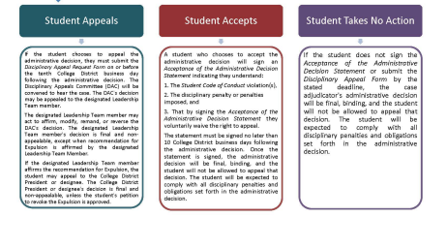
Student Disciplinary Process Flowchart-Con’t
Notes:
Cheri

Slide 33
Collin College’s Definition of Plagiarism?
Plagiarism includes, but is not limited to, intentionally or unintentionally failing to quote and cite words, information, and/or ideas taken from a source(s) in accordance with a citation style approved by the faculty member and/or inadequately paraphrasing (i.e. patchwriting or mosaic plagiarism).
2022-2023 Collin College Student Handbook p. 121
Notes:
Cheri
Need to understand Collin College’s definition of plagiarism, which may be different that your understanding of this term.

Slide 34
Collin College’s Definition of Plagiarism?
Plagiarism includes, but is not limited to, intentionally or unintentionally failing to quote and cite words, information, and/or ideas taken from a source(s) in accordance with a citation style approved by the faculty member and/or inadequately paraphrasing (i.e. patchwriting or mosaic plagiarism).
Notes:
Cheri
Intentional – Student forgot about an assignment and tried to turn in something at the last minute, so they could earn a grade, hoping they would not get caught.
Unintentional – Student forgot to check the word count on the assignment. Research paper had to be a MINIMUM of 1,000 words, student only had 820. Tried to add information to the paper at the last minute, but did not put one citation in quotation marks and did not provide any intext citation for a parenthetical source. Neither citation was included in the work cited page.

Slide 35
Collin College’s Definition of Plagiarism?
Plagiarism includes, but is not limited to, intentionally or unintentionally failing to quote and cite words, information, and/or ideas taken from a source(s) in accordance with a citation style approved by the faculty member and/or inadequately paraphrasing (i.e. patchwriting or mosaic plagiarism).
Notes:
Cheri
In college, writing assignments are given to help students prove that they understand the material that is being discussed in class. Therefore students must discern the difference between their thoughts, words, and ideas and what comes from some else.
Author’s words – quotations marks and give intext citation. Need to make sure the quoted material in their paper matches the source. (Martin Luther King Story)
Information – dates, definitions, facts, numbers and statistics, information that is not common knowledge, and qualifying words.
Ideas – proper paraphrase (where the words are yours, but the ideas come from your source, whether it is something you read, a podcast, or a video they watched)

Slide 36
Collin College’s Definition of Plagiarism?
Plagiarism includes, but is not limited to, intentionally or unintentionally failing to quote and cite words, information, and/or ideas taken from a source(s) in accordance with a citation style approved by the faculty member and/or inadequately paraphrasing (i.e. patchwriting or mosaic plagiarism).
Notes:
Cheri
Multiple citation styles required by college professors and you must use the required style appropriately.
Most common are MLA, Chicago Manual, and APA – you can’t wing it. If you don’t know the citation style that is required, go to the Writing Center or ask your professor for guidance

Slide 37
Collin College’s Definition of Plagiarism?
Plagiarism includes, but is not limited to, intentionally or unintentionally failing to quote and cite words, information, and/or ideas taken from a source(s) in accordance with a citation style approved by the faculty member and/or inadequately paraphrasing (i.e. patchwriting or mosaic plagiarism).
Notes:
Cheri
Borrowing words or ideas from another source too closely.

Slide 38
Types of Information that must be Cited Include, but are not Limited to:
Dates
Definitions
Facts
Numbers and Statistics
Information that is not “common knowledge”
Qualifying Words (e.g. “all,” “always,” “few,” “half,” “majority,” “many,” “most,” “never,” “none,” etc.
Example: If the city of Montreal, Canada does not change how they utilize their drinking water, by the year 2030 their water table will run dry (include citation here).
Example: Global warming has contributed to the melting of the ice cap and it is increasing sea levels at the rate of 10-20 cm per year (include citation here).
Notes:
Cheri
When qualifying words act like a number, then it would need to be cited.
Example: “The majority of registered voters in Collin County stated they would support legalizing marijuana for medical reasons, if it was listed on the ballot.

Slide 39
Comparison: Direct Quote and Paraphrase
(Topic: Healthcare for Migrant Workers)
Direct Quote
Paraphrase
“The multiple and complex barriers to accessible health care identified in this study include (a) dissimilarities in language and culture, (b) low levels of income, (c) powerlessness in the political arena, and (d) limitations of health resources” (Bechtel 18).
In their groundbreaking paper, Bechtel, Shepherd, and Rogers make a solid case that migrant workers face many obstacles to receiving quality health care (Bechtel 18).
Notes:
Cheri

Slide 40

What is Patchwriting or Mosaic Plagiarism?
“An inaccurate form of paraphrasing that relies too heavily on the source material. In these instances, direct quotes, pieces of information, phrases, and/or the original author’s ideas are not written completely in the student’s own words and properly cited”
(Collin College 2022-2023 Student Handbook p. 17)
This includes, but it is not limited to:
swapping out words for other’s that have similar meaning (i.e. thesaurus)
adding or subtracting words to make it appear as one’s own
switching the order in which words appear in the sentence
using someone else’s ideas, examples, or sentence structure
This Photo by Unknown Author is licensed under CC BY-NC-ND
Notes:
Cheri

Slide 41
Patchwriting or Mosaic Plagiarism
What the student submitted:
Original Source:
In the book/video, there are three vital parts to Alexander’s examination. In the first place, she convincingly contends that the current arrangement of mass detainment in the U.S. has primarily been driven fundamentally by the “Battle on Drugs.” In the mid 80’s, the Regan organization pronounced this conflict and to legitimize it . . .
I see three key parts to Alexander’s analysis. First, she convincingly argues that the current system of mass incarceration in the U.S. has been driven primarily by the “War on Drugs.” In the early 1980’s, the Reagan administration declared this war and to justify it . . .
Notes:
Cheri
Note: the word “primarily” was moved to a new location within the sentence, the student used the word ‘80s instead of using the 1980’s, and misspelled the last name of former President Ronald Regan.

Slide 42
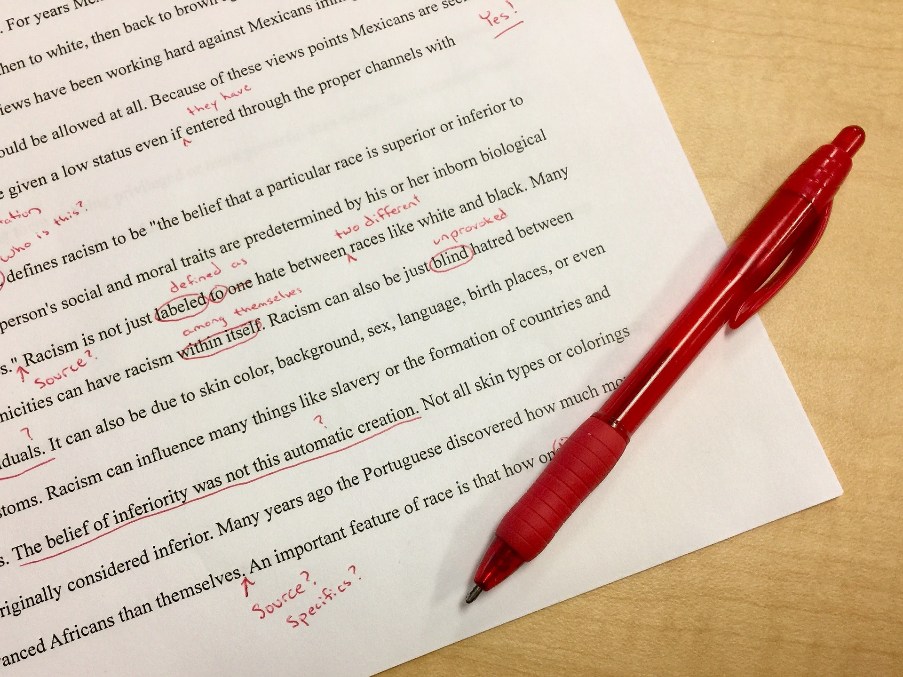
Tips to Avoid Plagiarism
Manage your time wisely.
Start writing assignments early.
After reviewing the source summarize the key information entirely in your own words and give credit (in-text and work cited page).
Consider how much directly quoted material you include in your paper.
Check direct quotes against the original document to ensure accuracy.
If you are not sure whether you should cite, go ahead and cite the source.
Ask the Writing Center or your professor for assistance.
This Photo by Unknown Author is licensed under CC BY
Notes:
Cheri
#4 Professors want to know what you think, not how well you can cut and paste material from outside sources to make the word count requirements of your paper.

Slide 43

Cheating (Most Common Offenses)
Using unauthorized or wearable devices while taking a quiz or examination (i.e., Apple Watch or smart watch, cell phone, etc.).
Submitting or resubmitting an assignment in whole or in part (i.e. recycling an assignment or self-plagiarism.
Violating a faculty member’s and/or Testing Center’s testing policies and procedures.
Attempting to fulfill the requirements of a course through any other dishonest means.
This Photo by Unknown Author is licensed under CC BY
Notes:
Cheri
Dishonest means: using someone else’s paper as a “guide” to write your own.
Falsifying a note

Slide 44
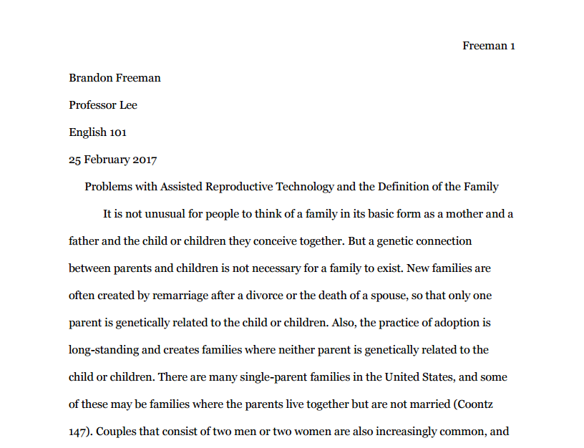
Collusion
Bottom line: If you need to submit a document to your professor and it only lists your name, it should be a reflection of your own, individual academic work.
Intentionally or unintentionally helping someone else commit scholastic dishonesty by:
providing an inappropriate level assistance
working with another student on an assignment, project, quiz, or exam without the professor’s permission,
sharing a paper or a project with another student without the professor’s permission.
This Photo by Unknown Author is licensed under CC BY-SA
Notes:
Cheri

Slide 45
Final Reminders
When in doubt, check COLLIN’s canvas, and check COLLIN email
The student is the main person who needs to contact the professor
If you have questions about your child’s grade, please ask them to pull up their Collin canvas account.
You are a college student, and please make sure to fully enjoy this experience—it’s a super neat opportunity for them to develop:
  Personally
  Professionally
  Academically
  Emotionally
  Socially
Notes:
Justin

Slide 46

QUESTIONS?
I am here to help you succeed, feel free to reach out to me at any time.
JARobinson@Collin.edu
Feel free to scan QR code as well! ☺
Notes:
Jessica

